Slide 1
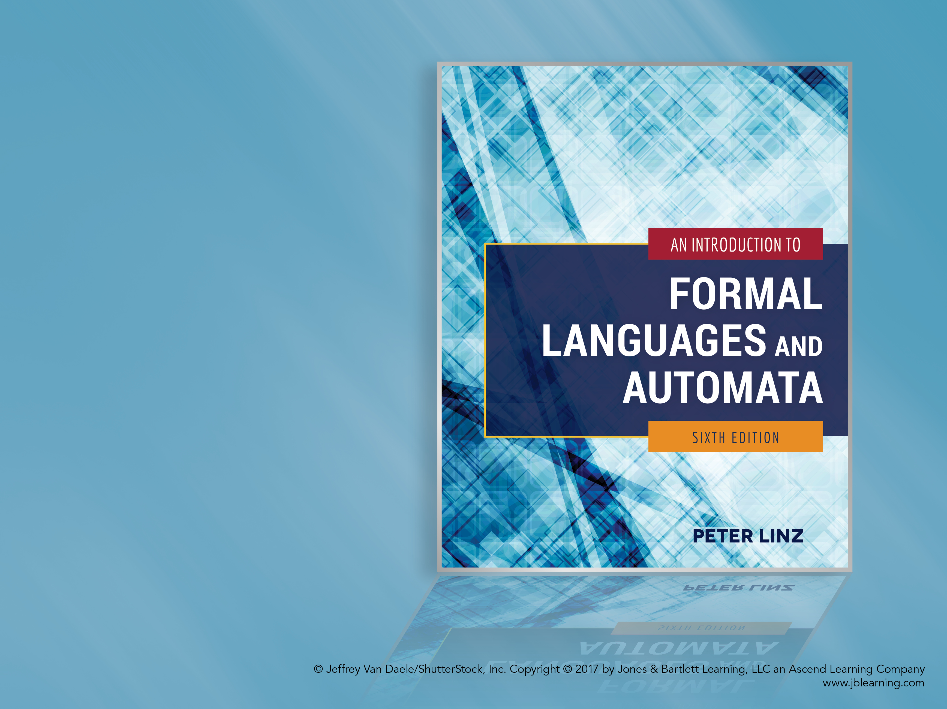
Chapter 14
AN OVERVIEW OF COMPUTATIONAL COMPLEXITY

Slide 2

Learning Objectives At the conclusion of the chapter, the student will be able to:
Explain the concept of computational complexity as it relates to Turing machines
Describe deterministic and nondeterministic solutions to the SAT problem
Determine if a Boolean expression in CNF is satisfiable
Describe the efficiency of standard Turing machines that simulate two-tape machines and of those that simulate nondeterministic machines
Define the complexity classes P and NP, as well as the relationship between P and NP
Explain the concepts of intractability and NP-completeness
List some well-known NP-complete problems
Discuss the significance and status of the P = NP? question

Slide 3
Efficiency of Computation
Computational complexity is the study of the efficiency of algorithms
When studying the time requirements of an algorithm, the following assumptions are made:
The algorithm will be modeled by a Turing machine
The size of the problem will be denoted by n
When analyzing an algorithm, the focus is on its general behavior, particularly as the size of the problem increases
A computation has time-complexity T(n) if it can be completed in no more than T(n) moves on some Turing machine

Slide 4
Turing Machine Models and Complexity
Although different models of Turing machines are equivalent, the efficiency of a computation can be affected by the number of tapes available and by whether it is deterministic or nondeterministic
Consider the Satisfiability Problem (SAT): given a Boolean expression e in conjunctive normal form, find an assignment of values to the variables so that e is true
For example, the expression e₁ = (x₁’ ∨ x₂) ∧ (x₁ ∨ x₃) is true when x₁ = 0, x₂ = 1, and x₃ = 1
However, the expression e₂ = (x₁ ∨ x₂) ∧ x₁’ ∧ x₂’ is not satisfiable

Slide 5
Solving the Satisfiability Problem
A deterministic algorithm would take all possible values for the n variables and evaluate the expression for each combination
Since there are 2^{n} possibilities, the deterministic solution has exponential time complexity
A nondeterministic algorithm would guess the value of each of the n variables at each step and evaluate each of the 2^{n} possibilities simultaneously, thus resulting in an O(n) algorithm
There is no known nonexponential deterministic algorithm for solving the SAT problem

Slide 6
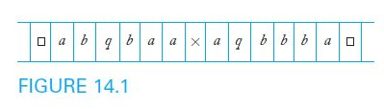
Simulation of a Two-Tape Machine
Theorem 14.1 states that, if a two-tape machine can carry out a computation in n steps, the computation can be simulated by a standard Turing machine in O(n²) moves
To simulate the two-tape computation, the standard machine would
Keep a description of the two-tape machine on its tape
For each two-tape move, search the entire active area of its tape
After n moves, the active area has a length of at most O(n), so the entire simulation takes O(n²) moves

Slide 7
Simulation of a Nondeterministic Machine
Theorem 14.2 states that, if a nondeterministic machine can carry out a computation in n steps, the computation can be carried out by a standard Turing machine in O(k^{an}) moves, where k and a are independent of n
To simulate the nondeterministic computation, the standard machine would keep track of all possible configurations, searching and updating the entire active area of its tape
If k is the maximum branching factor for the nondeterministic machine, after n steps there are at most k^{n} possible configurations, and the length of each configuration is O(n)
Therefore, to simulate one move, the standard machine must search an active area of length O(nk^{n})

Slide 8
Considerations Affecting Complexity Classes and Languages
It is difficult to classify languages by the complexity classes associated with the corresponding Turing machine acceptors
Since the particular model of Turing machine used affects the complexity of the associated algorithms, it is difficult to determine which variation to use as the best model of an actual computer
The efficiency differences between deterministic and nondeterministic algorithms can be much more significant than differences between alternative deterministic algorithms involving different numbers of available tapes

Slide 9
The Complexity Classes P and NP
There are two famous complexity classes associated with languages: P and NP
P is the set of all languages that are accepted by some deterministic Turing machine in polynomial time, without any regard to the degree of the polynomial
NP is the set of all languages that are accepted by some nondeterministic Turing machine in polynomial time

Slide 10
The Relationship Between P and NP
Obviously, P ⊆ NP
What is not known is whether P is a proper subset of NP, in other words,
is P ⊂ NP or P = NP?
While it is generally believed that there are languages in NP which are not in P, no one has yet found a conclusive example
Because of its significance on the feasibility of certain computations, this question remains the most fundamental unresolved problem in theoretical computer science

Slide 11
Intractability
A problem is intractable if it has such high resource requirements that practical solutions are unrealistic, although the problem may be computable in principle
Algorithms for solving intractable problems consume an extraordinary amount of time for nontrivial values of n on any computer available now or in the foreseeable future
According to the Cook-Karp thesis, a problem in P is tractable, and one not in P is intractable

Slide 12
Some NP Problems
The following problems, among others, can be solved nondeterministically in polynomial time:
The Satisfiability problem
The Hamiltonian path problem: given an undirected graph with n vertices, find a simple path that passes through all the vertices
The Clique problem: given an undirected graph with n vertices, find a subset of k vertices such that there is an edge between every pair of vertices in the subset
These problems have deterministic solutions with exponential time complexity, but no deterministic polynomial solution has been found

Slide 13
Polynomial-Time Reduction
Since NP problems have similar characteristics, it is convenient to determine if they can be reduced to each other
A language L₁ is polynomial-time reducible to another language L₂ if there exists a deterministic Turing machine that can transform any string w₁ in L₁ to a string w₂ in L₂ so that
The transformation can be completed in polynomial time, and
w₁ is in L₁ if and only if w₂ is in L₂
Consider 3SAT, a modified version of the SAT problem in which each clause can have at most three literals; as shown in Examples 14.9 and 14.10,
The SAT problem is polynomial-time reducible to 3SAT
The 3SAT problem is polynomial-time reducible to CLIQUE

Slide 14
NP-Completeness
Some problems have been identified as being as complex as any other problem in NP
A language (or problem) L is NP-complete if
L is in NP, and
Every problem in NP is polynomial-time reducible to L
As stated in Theorem 14.5, the Satisfiability Problem is NP-complete
This definition is very significant because, if a deterministic polynomial-time algorithm is found for any NP-complete problem, then every language in NP is also in P

Slide 15
An Open Question: P = NP?
Computer scientists continue to look for an efficient (deterministic, polynomial-time) algorithm that can be applied to all NP problems, therefore concluding that P = NP
On the other hand, if a proof is found that any of the NP-complete problems is intractable, then we can conclude that P ⊂ NP and that many interesting problems are not practically solvable
In spite of our best efforts, no efficient algorithm has been found for any NP-complete problem, so our conjecture is that P ≠ NP
However, until a proof is found, P = NP? remains the fundamental open question in complexity theory

